Slide 1
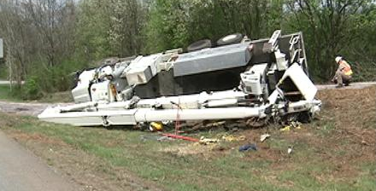
Heavy Equipment and
Work-Zone Safety

Slide 2
Overview
Work Zones
  Stats
  Identifying Hazards in the Job Site
  Work-Zone Precautions
  Control Measures
General Heavy Equipment Safety
Specific Equipment
  Stats
  Cautions
  Safety Recommendations

Slide 3



Work Zones

Slide 4
Fatalities in Construction and Maintenance Work Zones
Average Number of Fatalities in Work Zones
  1994-1999: 778
  2000-2006: 1060
  2007-2012: 669
Reasons for the Decline after 2006
  Better Safety Procedures
  Distracted Driving Laws

Slide 5
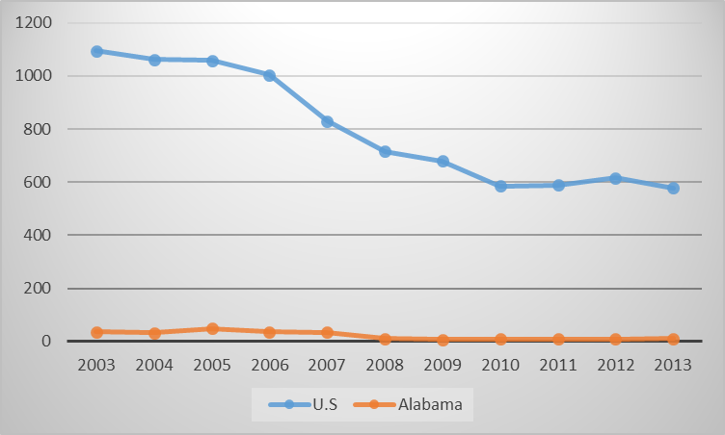
Work Zone Fatalities Due to Motor Vehicle Accidents
Total Fatalities 2003-3013: 8,819
Alabama Fatalities: 248

Slide 6
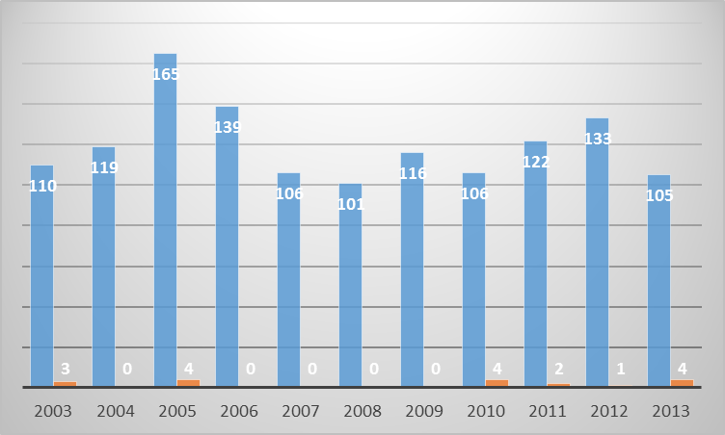
Worker Fatalities in Work Zones Due to
Motor Vehicle Accidents
Total Fatalities 2003-3013: 1,322
Alabama Fatalities: 18

Slide 7
Worker Fatalities in Work Zones Due to
Motor Vehicle Accidents
2003-2007: 639 Workers were Killed at Road Construction Site
  Nearly Half Were Attributable to the Worker Being Struck by a Vehicle or Mobile Equipment
  Overturned Equipment, Falling Objects, and Falls from Vehicles and Mobile Equipment
In 2013 Transportation Incidents Accounted for 66% of all Worker Fatalities in Highway Work Zones
  Backing Vehicles Accounted for 56%
  60% of Backing Incidents Involved a Dump Truck

Slide 8
Highway Worker Fatalities
Other
18%
Construction Equipment
41%
Vehicle Entering
Work Area
22%
Traffic Crash
19%
Source: Bureau of Labor Statistics

Slide 9
Highway Equipment Related Fatalities
Passengers
8%
Workers on Foot
57%
Operators
35%
Source: Bureau of Labor Statistics

Slide 10

Identifying Hazards in the Work Zone

Slide 11
Job Safety Analysis
Break Down the Task Into a Series of Steps and Examining Each Step for Potential Hazards
Examine the Relationship Between the Worker, the Task, the Environment, and the Tools or Equipment Being Used
Consult with the Workers Performing the Task. They Have Intimate Knowledge of Their Processes and Equipment
Examine Accident (Loss) History
Implement the Best Control Methods
Notes:
Loss Control services include on site visits and assistance to members in establishing safety programs

Slide 12
Work Zone Issues
Acceleration/Deceleration lanes
  Short or Non-Existent
Signage Indicating Merge/Exit Points
  Signs Give Vague Information
  Messages Left Up 24/7
Flagging operations
  Works Best with Low Traffic and Moderate Construction Trucks
  Proper Rules are Forgotten (Manual on Uniform Traffic Control Devices for Streets and Highways)
Information Must be Accurate and REAL TIME!

Slide 13
Control Methods
Personal Protective Equipment
  Hard-Hats, Safety Vests, Glasses, etc
Traffic Control Devices
  Flaggers
  Signage
  Internal Traffic Control Plan
  Intrusion Alarms
Safety Meetings
  Daily, Prior to Beginning Work
  As Needed Throughout the Day

Slide 14
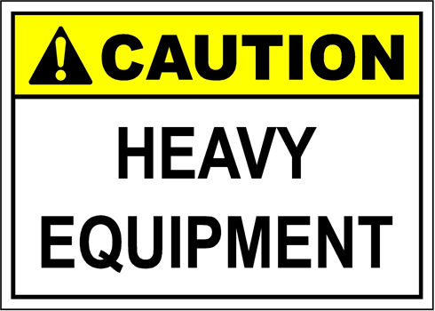
Heavy Equipment Safety

Slide 15
General Safety
Properly Enter and Exit Machines
  Always face the equipment and use steps and rails
  Maintain three points of contact when mounting or dismounting
  Ensure the contact areas are clear of mud and debris
Wear Seat Belts
  Keeps the worker inside the cab’s rollover protection structure

Slide 16
General Safety
Know where underground lines are buried
Recognize the hazards
  Steep slopes, tight spaces, and overhead lines can present danger
  Attempt to recognize all potential hazards before proceeding. If you’re not sure, ASK!
Secure Loads Properly
  Refer to operator’s manual for guidelines on proper loading and transport procedures
  Always load and unload on level surfaces
  Ensure breaks are locked before loading
  Ensure trailers are properly hitched

Slide 17
General Safety
Wear Proper Clothing
  Keep clothing tight. Loose clothing can get caught
  Proper footwear not only protects from falling objects but also helps to prevent falls
  Gloves and long pants help prevent cuts
Make Safe Tool Changes
  Understand the different warning labels regarding the forks, buckets, and other tools
  Know the maximum operating capacities
  Always check hoses and fitting on the tool as well as the machine before changing the tool

Slide 18
General Safety
Conduct Pre-Work Checks
  Inspections take only minutes but are the best way to detect small problems before they become serious
  Follow guidelines in the operating manuals, which should be kept on the machine
  Clean the machine before and after using
Make the Shop Safe
  When working on the equipment, ensure all safety locks are in place
  Proper ventilation and lighting
  EYE PROTECTION

Slide 19
General Safety
Establish a Culture of Safety – and a Commitment to Training
  Prepare a safety manual or safety sheet for the specific task and conditions of your site
  Ensure all equipment is used for its intended purpose
  Provide regular safety training
  Be certain new workers are trained before they start working

Slide 20
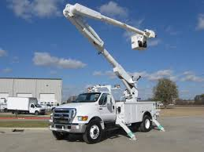
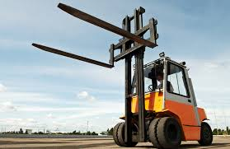
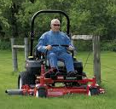
EQUIPMENT

Slide 21
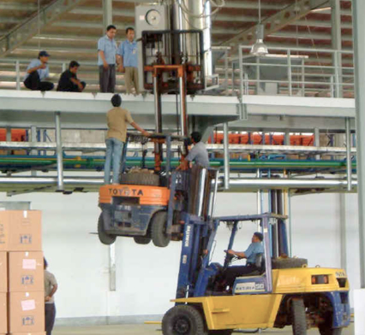
Forklifts
Fatal Forklift Accidents
Fatal Accident Type | %
Crushed by Vehicle Tipping Over | 42%
Crushed Between Vehicle and a Surface | 25%
Crushed Between Two Vehicles | 11%
Struck or Run Over by a Forklift | 10%
Struck by Falling Material | 8%
Fall From Platform on the Forks | 4%

Slide 22
Forklifts
100 fatal Forklift accidents per year
20,000 accidents resulting in serious injury every year
61,800 non-serious accidents per year
1 out of every 10 forklifts will be involved in an accident this year
42% of fatalities are caused by the operator trying to jump from a tipping forklift
Average incurred cost of forklift injuries - $4,862
1 in 5 forklift related injuries involve hitting employees on foot who are unaware of the use of forklifts in the area
Notes:
Assuming 1 accident per forklift; 1 out of every 10 forklifts will be involved in an accident every year

Slide 23
Forklifts
  Qualified and well-trained operators
  Appropriate clothing
  Examine the equipment before use
  Always consider the surrounding environment
  Operate at a safe speed
  Ensure a stable load
  Ensure clear visibility
  Never stand or walk under the load
  Use forklifts for carrying loads only
  Secure the forklift when not in use

Slide 24
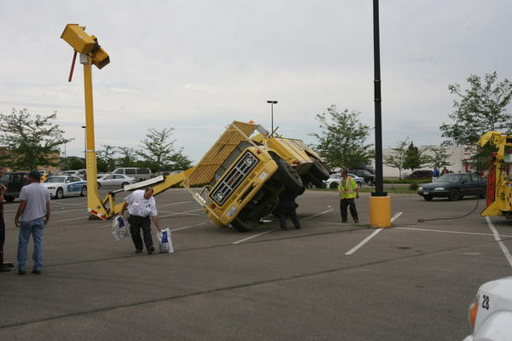
Bucket Trucks
Causes of Aerial Lift Deaths (1992-1999)
Cause | Number of Deaths
Electrocutions | 62
Falls | 35
Collapses/Tipovers | 23
Caught In/Between | 11
Struck By/Against | 6
Other Causes | 5
Total | 142
Notes:
In May 2015 had a worker killed in an incident in South Alabama (Enterprise)
Average of 26 deaths per year from aerial Lifts

Slide 25
Bucket Trucks
Average of 26 deaths per year from aerial lift accidents
Half of all falls from boom lifts involved being ejected from the bucket after being struck by other mobile equipment, or by falling objects
2/3 of the deaths from collapses of boom lifts occurred when the bucket cable or boom broke; 1/3 were due to tipovers
Half of boom lift electrocutions involved body contact with overhead power lines; 1/3 involved an overhead power line contacting the lift boom or bucket
In most of the caught in/between deaths, a worker was caught between the bucket edge and another object such as roof joists or beams while attempting to reposition the bucket

Slide 26
Bucket Trucks
Safety checks to include:
  Daily checks of the equipment (broken or damaged parts, tires, rust, and all required lighting)
  Worksite inspections (level ground, overhead obstructions, approaching traffic)
  Annual Inspections (structural test, dielectric test, functional and operational testing)
Fall Safety
  ALWAYS WEAR FALL PROTECTION
  Always keep feet on the floor of the bucket
  Do not carry ladder in the bucket
  Do not exceed load capacity
  Never modify the lift without permission from the manufacturer
  Never use the lift as a crane

Slide 27
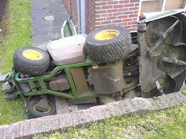
Zero-Turn Mowers/Tractors
Rollovers of zero-turn mowers contributed to more than 15,000 injuries and 61 deaths in 2007
An average of 218 deaths every year from tractor accidents (120 from overturns)
Most of these fatalities occur to operators 65 years and older
Backing is the second leading cause of incidents with mowers and tractors

Slide 28
Tractors/Mowers
Zero-turn mowers are risky when used on terrain with at least a 10-degree slope (rises 20 in over a 10 ft span)
Utilize Rollover Protective Structure and seatbelts TOGETHER. (if the seatbelt is not used, the ROPS can become a crushing device; if ROPS is not used the seatbelt can trap the operator)
Know your equipment and all its controls
Never remove safety guards or alter the equipment without manufacturer approval
WEAR PROPPER PPE and PROPER CLOTHING
  Glasses protect eyes from projectiles
  Long pants and tight fitting clothing

Slide 29

Questions?

Slide 30
References
Caterpillar Safety Service - https://safety.cat.com/
Hyster Forklifts - http://www.hyster-bigtrucks.com
OSHA - https://www.osha.gov
Electronic Library of Construction Occupational Safety & Health – www.elcosh.org
Manual on Uniform Traffic Control Devices for Streets and Highways
Consumer Reports Magazine – www.consumerreports.org

